Slide 1


Intro to
Programming
With python
Dictionaries:
practice
Friday, April 18 2025 TOH210
Worksheet up on Moodle!
Notes:
Layout objects pulled from: https://slidesgo.com/
All icons are from: https://thenounproject.com/

Slide 2

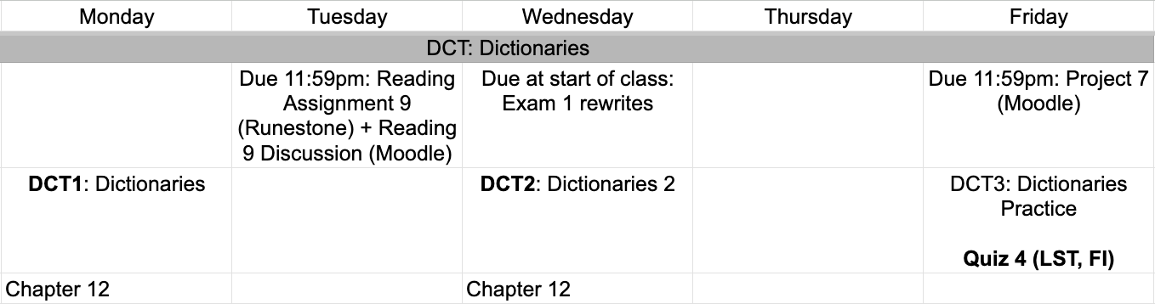
This week
google sheet link
drop by office hours today (3-4) for help on Project 7
Notes:
https://docs.google.com/forms/d/e/1FAIpQLSe3OloPAJSid4n6cyU_4qXpRWU7FOSmP7IVdRS_vh9cvYd9zQ/viewform?usp=sharing

Slide 3
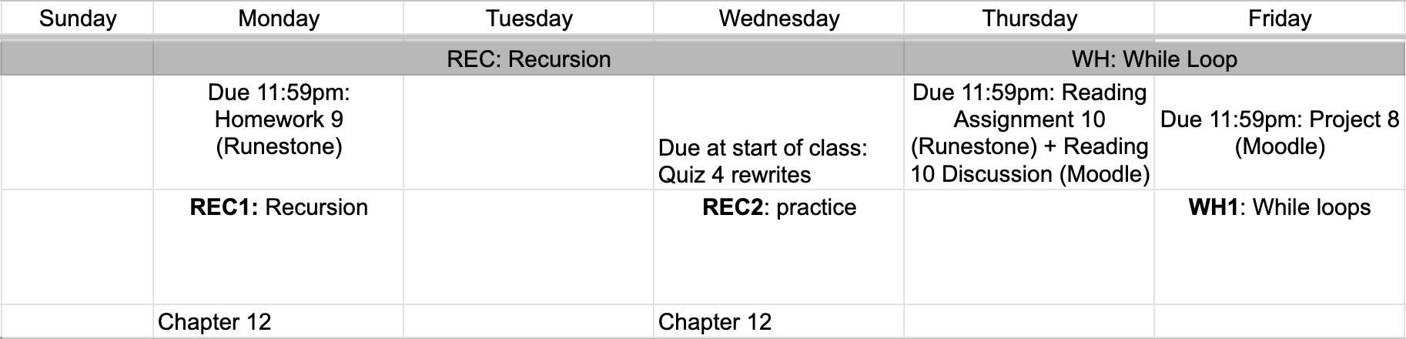
Next week
google sheet link
Notes:
https://docs.google.com/forms/d/e/1FAIpQLSe3OloPAJSid4n6cyU_4qXpRWU7FOSmP7IVdRS_vh9cvYd9zQ/viewform?usp=sharing

Slide 4
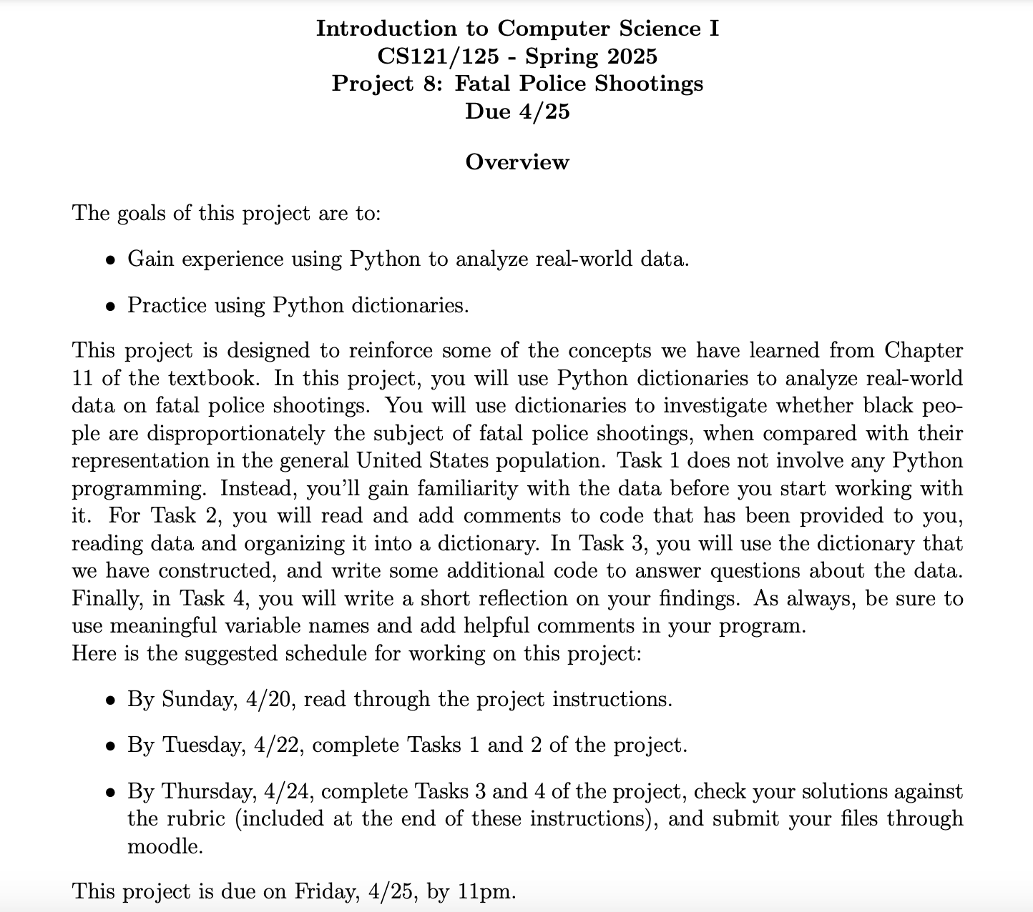
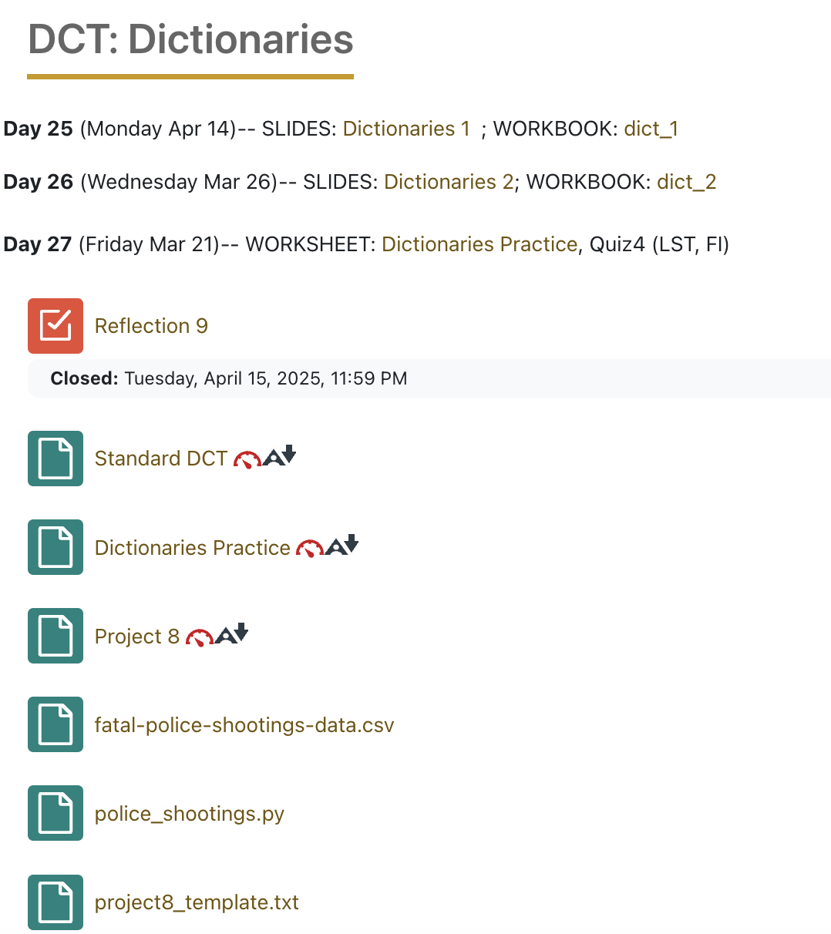

Slide 5

We will start the quiz at 12:30 (121) or 1:35 (125)
dictionary practice
We’re going to spend the rest of class time (until our quiz), working on the worksheet up on Moodle.
You’ll need to create a python file for each question (so, two of them). Grab a partner and a whiteboard marker. One person will plan out each question on the board. The other person will put the ideas into a Python file, adding comments for the plan.
For each question, plan out on the board, then identify the correct Python code required to answer the question. Move on to the next question.

Slide 6

before next time
Finish workbook
Submit Project 7
Start Homework 9
Read over Project 8

